Slide 1


SPRINGBOARD INTERNSHIP 2.0
INFOSYS
Sarcasm Detection on Airline Reviews
Virtual Internship on Data Science
Supervised By: Mahesh
BY PRAJNA AASRITHA ADABALA
May 2024 – July 2024
July 15-07-2024

Slide 2
WHAT’S THE CONTENT?
Business Problem
Solution Overview
Dataset Description
Data Visualization
Data Preprocessing
Model Training
Results
Conclusion

Slide 3

BUSINESS PROBLEM
Airlines receive numerous customer reviews daily These reviews provide valuable insights into customer experiences.
However, identifying sarcasm in these reviews is a significant challenge.
Sarcastic comments often carry the opposite meaning of what is explicitly stated.
The misinterpretation of sarcastic reviews can lead to several issues:
Misguided Business Decisions
Reputation Damage
Poor Customer Service

Slide 4
SOLUTION OVERVIEW
To address this problem, we are developing an advanced sarcasm detection system.
The solution involves several key components:
Data Collection and Labelling
Data Preprocessing
Model Training
Evaluation and Optimization
By accurately detecting sarcasm, airlines can:
Improve Sentiment Analysis
Enhance Customer Service
Make Informed Decisions

Slide 5
DATASET DESCRIPTION
The dataset consists of 23,000 reviews from different airlines, labeled as sarcastic or non-sarcastic.
Each review provides insights into customer experiences with airline services, such as food, wi-fi, staff behavior, in-flight amenities, and overall satisfaction.
Examples of Reviews:
"Sure, I just love spending 6 hours on the tarmac."
Label: Sarcastic
"The flight was delayed again, just perfect."
Label: Sarcastic
“I had a great time. The staff were kind."
Label: Non-Sarcastic

Slide 6
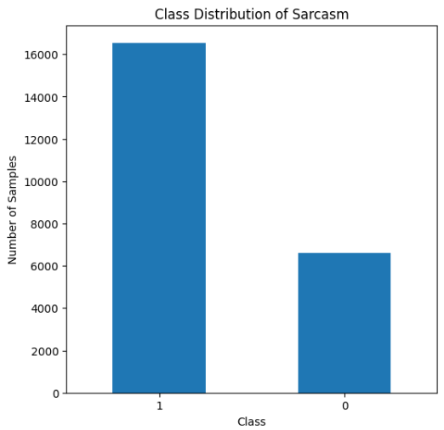
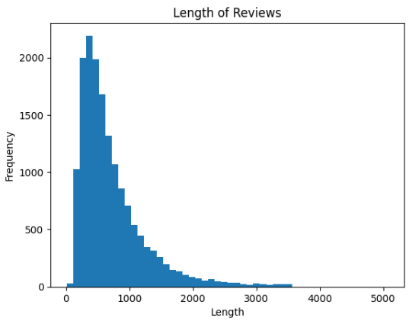
DATA VISUALIZATION
A bar chart was used to visualize the distribution of sarcastic and non-sarcastic reviews.
This visualization highlights the imbalance in the dataset.
Sarcastic: 16,548 reviews
Non-Sarcastic: 6,623 reviews
Fig. 1
Fig. 2

Slide 7
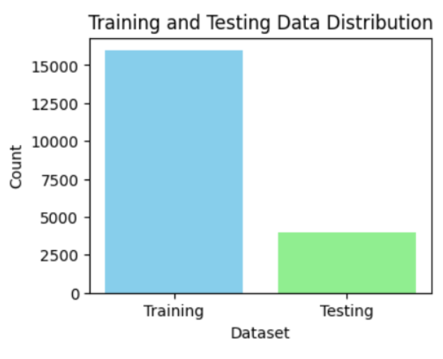
DATA VISUALIZATION
A bar chart was used to visualize training and testing data distribution. Fig. 3 shows the visual distribution.
Training set: 15947
Non-Sarcastic set: 4000
Fig. 3

Slide 8
DATA PREPROCESSING
A Subset of the dataset (About 18000) is taken to clean and prepare the data for modeling.
Data Cleaning
Preprocessing
Removal of HTML tags, URLs, mentions, and hashtags.
Elimination of special characters
Conversion to lowercase.
Removal of stopwords to focus on relevant text content.
Utilized BERT Tokenizer for efficient text tokenization.
Employed Word2Vec to convert words into vector representations.
Applied label encoding to convert categorical labels into numerical format.

Slide 9
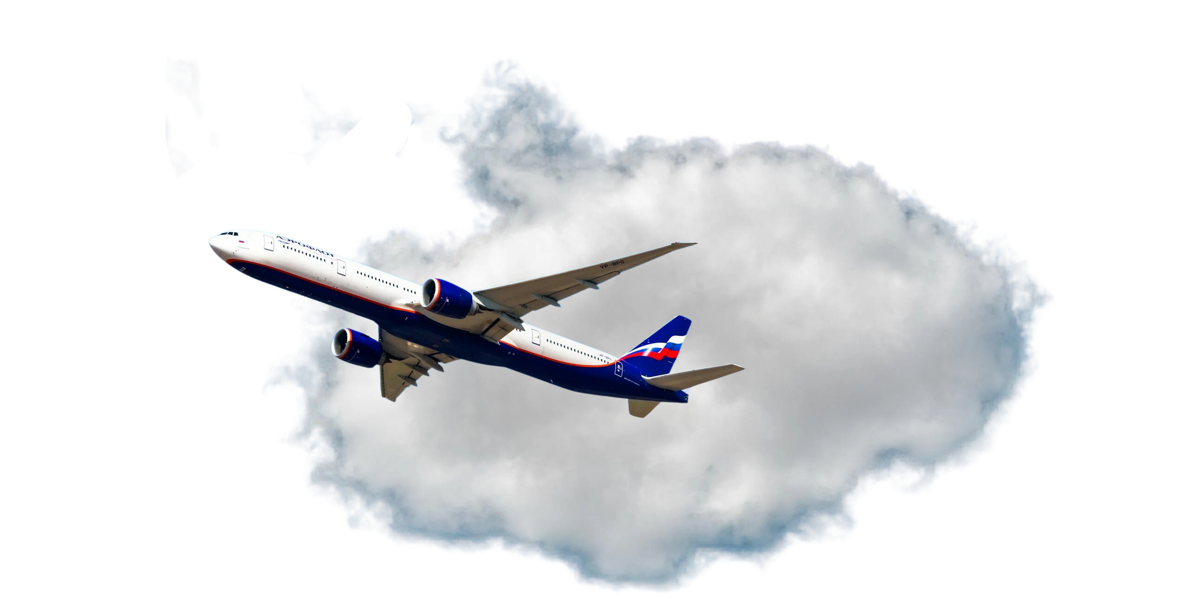
DATA PREPROCESSING
Handling Imbalanced Data
we used SMOTE (Synthetic Minority Over-sampling Technique) to create synthetic samples of the minority class.
The working of the tokenizer and vectorizer and their advantages:
The BERT tokenizer converts text into lowercase, splits the words, handles special characters, and handles out-of-vocabulary words by using Sub-word tokenization.
The Word2vec vectorizer is a two-layer neural network that processes text by converting words into numerical vectors.

Slide 10
MODEL TRAINING
Trained various machine learning and deep learning models to detect sarcasm:
Random Forest, Support Vector Machine (SVM), Logistic Regression, Gradient Boosting.
Simple Neural Network, LSTM, BiLSTM, CNN, and a hybrid CNN-LSTM model.
Evaluated model performance using standard metrics:
Accuracy: Measures overall model correctness.
Precision: Indicates the ratio of correctly predicted positive observations to the total predicted positive observations.
Recall: Reflects the proportion of actual positive instances that were correctly predicted.
F1 Score: Harmonic mean of precision and recall, providing a balanced evaluation metric.

Slide 11
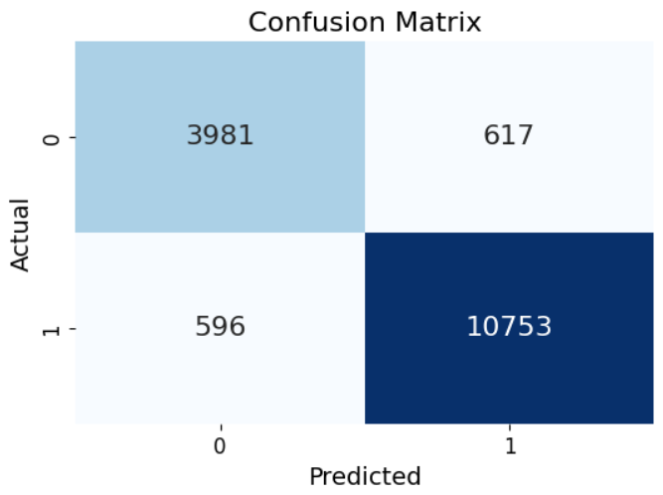
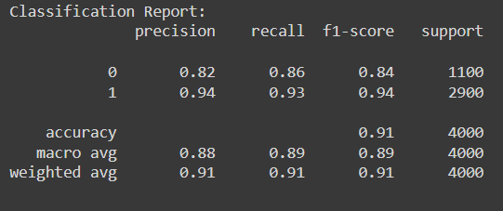
RESULTS
Best Model Performance
Identified the BERT-LSTM model as the best performer with an accuracy of 91% and balanced precision and recall scores.
Fig. 3 Fig 4

Slide 12
CONCLUSION
The sarcasm detection system enhances the airline industry's ability to analyze customer feedback accurately.
By distinguishing sarcastic from genuine reviews, airlines can:
Improve customer service responses.
Make informed operational decisions.
Safeguard and enhance their reputation.
Discussion
Addressing sarcasm in text data requires nuanced understanding and robust NLP techniques.
Future enhancements could involve integrating more advanced NLP models and expanding the dataset for broader coverage.
The system offers substantial benefits by aligning airline operations with genuine customer sentiments, ultimately improving service quality and customer satisfaction.

Slide 13
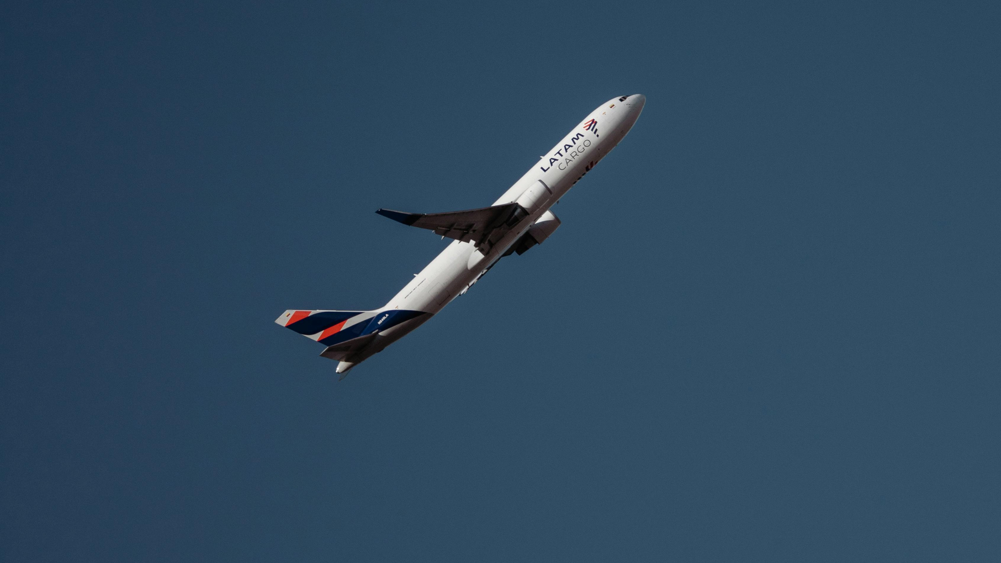


THANK YOU!

